Slide 1
Web - JEE

Slide 2
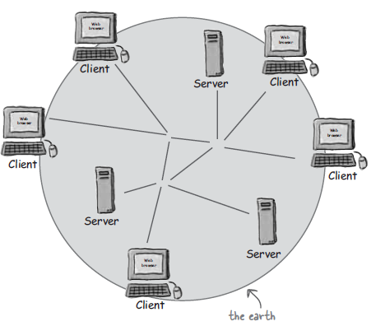

Slide 3
What does web server do?
A web server takes client request and gives something back to client.

Slide 4
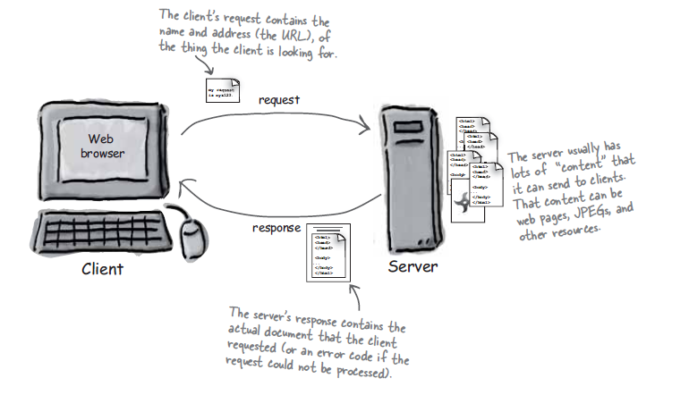

Slide 5
What does a web client do?
A web client lets user request something on the server and shows the result of the request

Slide 6
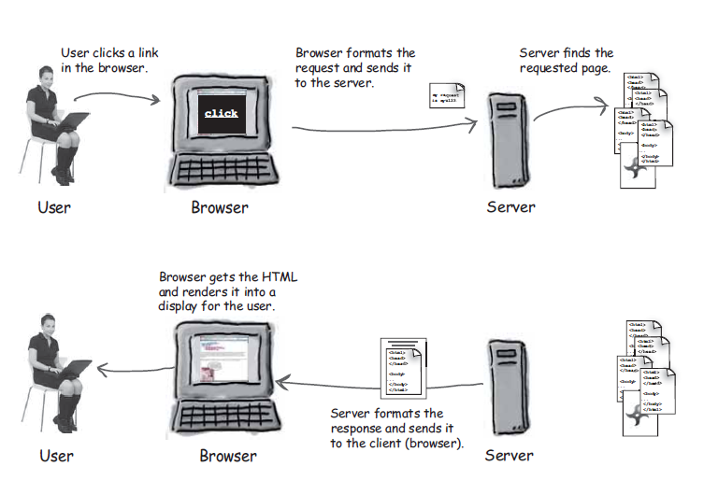

Slide 7
Clients and Servers know HTML and HTTP.
HTML tells the browser how to display the content to the user.
HTTP is the protocol clients and servers use on the web to communicate.
The Server uses HTTP to send HTML to client.

Slide 8
HTML- Demo

Slide 9
What is HTTP protocol?
HTTP runs on top of TCP/IP.
The structure of an HTTP conversation is simple Request/Response sequence.
Browser requests and a Server Responds

Slide 10
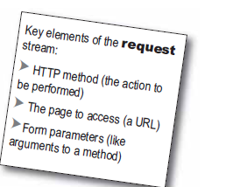
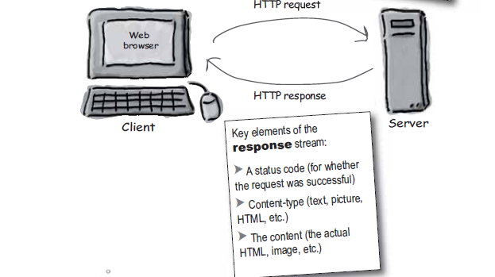

Slide 11
HTML is part of the HTTP Response

Slide 12
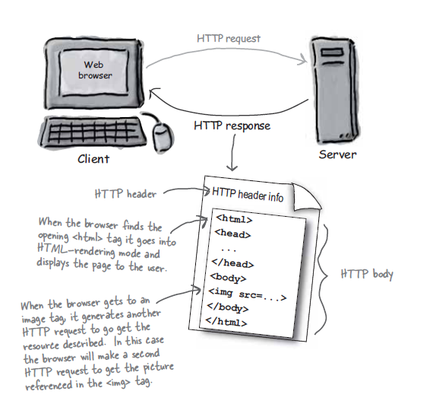

Slide 13
If that is the Response? What is in the Request?
HTTP method
GET and POST

Slide 14
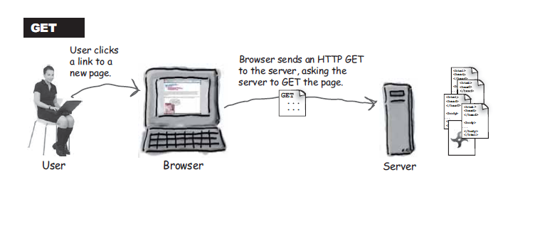

Slide 15
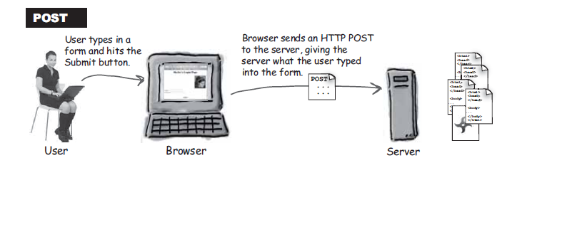

Slide 16
GET is a Simple Request
POST can send User Data

Slide 17
GET is simple HTTP Method.
Ask the server to get Resource
Resource might be an HTML page, Image, PDF, etc
POST is a more powerful request.

Slide 18
Other HTTP Methods
HEAD
TRACE
CONNECT
DELETE
OPTIONs
PUT

Slide 19
Its true we can send small amount data with HTTP GET request.
Total amount of characters in a GET is really limited ( Depending on Server ).
The Data we send with GET, will appended with URL.
GET Request URL can bookmarked on web browser.

Slide 20
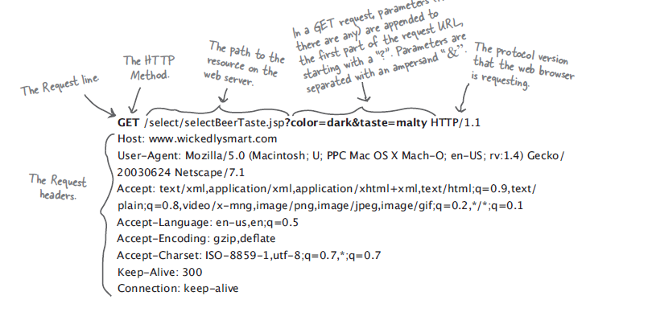
HTTP GET Request

Slide 21
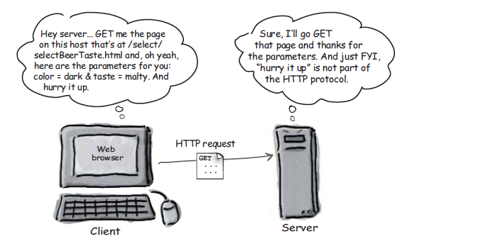

Slide 22
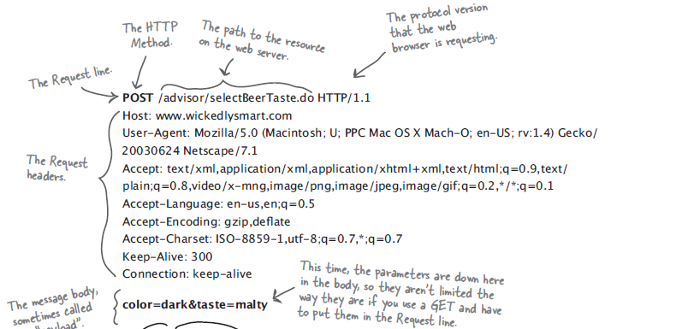
HTTP Post Request

Slide 23
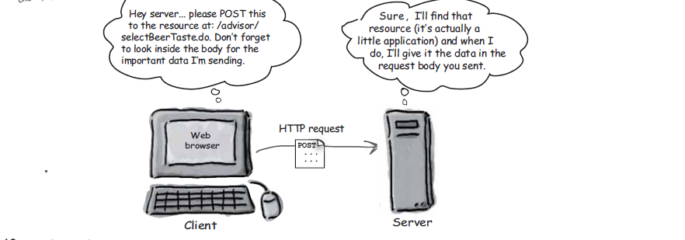

Slide 24
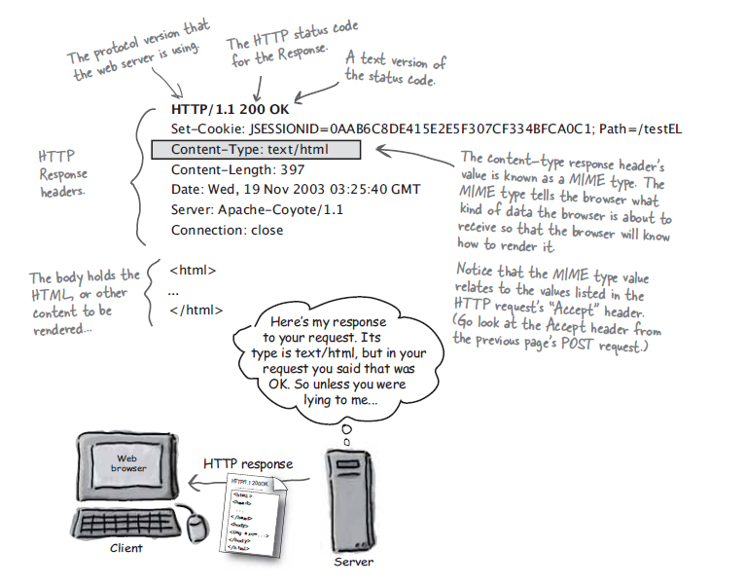
HTTP Response

Slide 25
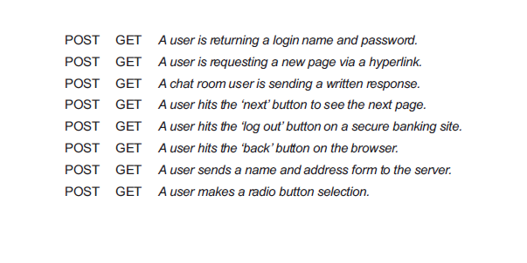

Slide 26
URL

Slide 27
All Web Servers love serving static Web Pages.

Slide 28
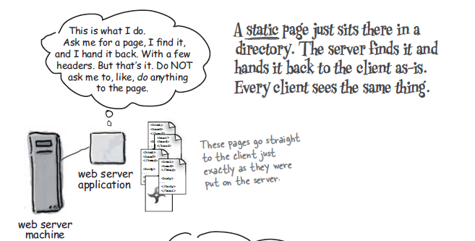

Slide 29
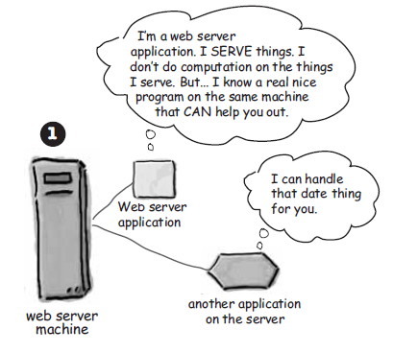
WEB Server+ Web Container

Slide 30
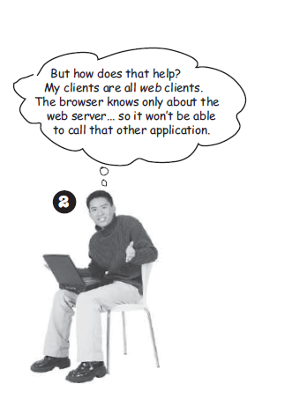

Slide 31
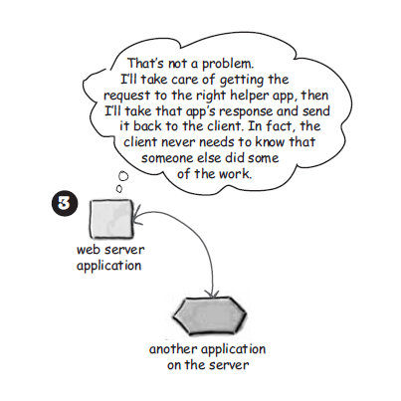

Slide 32
Two things the web Server alone can’t do
Dynamic Content
Saving Data on Server

Slide 33
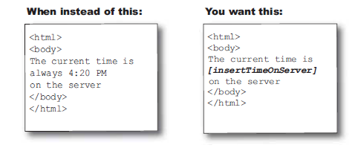
Static Vs Dynamic

Slide 34
Dynamic Components
Servlet
JSP

Slide 35
What is Web Container?
Servlets don’t have main(). They are under the control of another Java Application called Container.

Slide 36
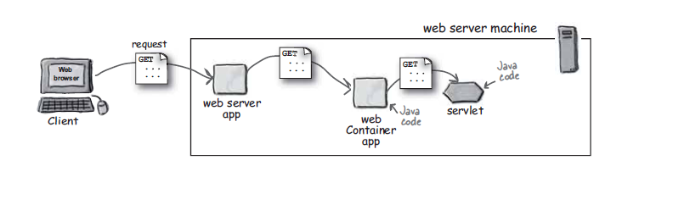

Slide 37
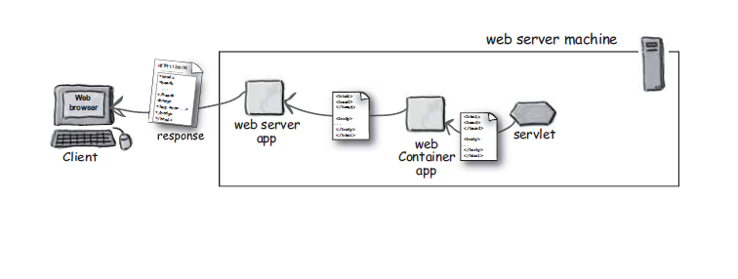

Slide 38
What if you had Java? But no Servlets or Containers.

Slide 39
What the does container gives us?
Communication Support
Life Cycle Management
Multi Threading Support
Declarative security
JSP Support

Slide 40
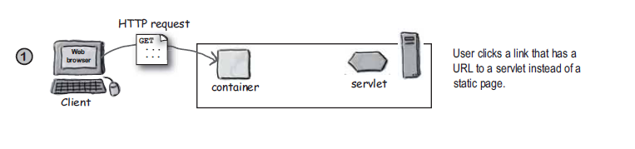
How Container will handles a Request

Slide 41
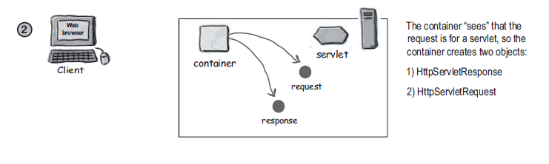

Slide 42
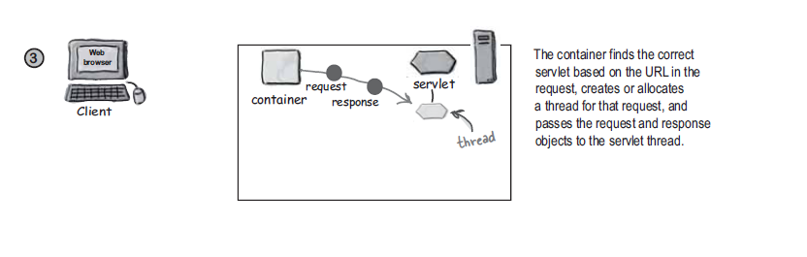

Slide 43
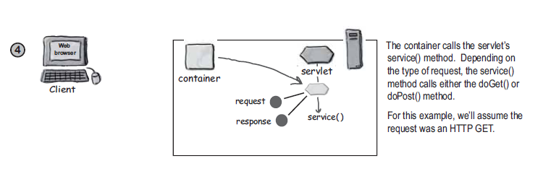

Slide 44
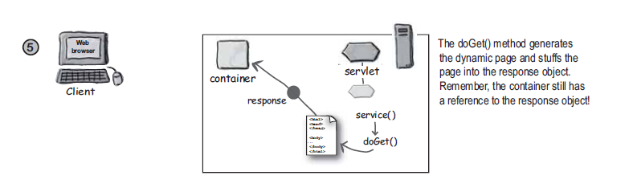

Slide 45
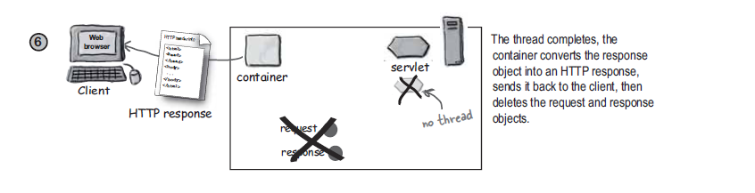

Slide 46
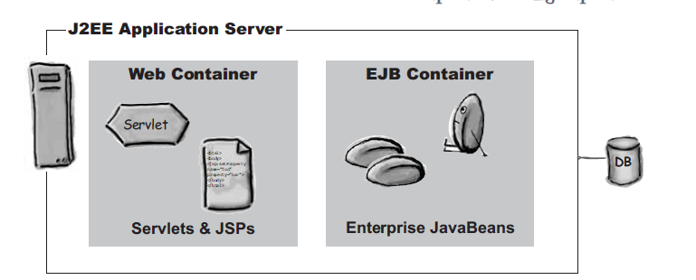

Slide 47






J2EE Servers
Application Server
As of Sept ’01 - MetaGroup Survey by sales $$
BEA Weblogic - 37%
IBM Websphere – 22%
Oracle – 11%
Iplanet – 5%
Other- 12%
Open-source
Jboss – www.jboss.org
Sun’s listing of J2EE compatible servers - http://java.sun.com/j2ee/compatibility.html

Slide 48
Example

Slide 49
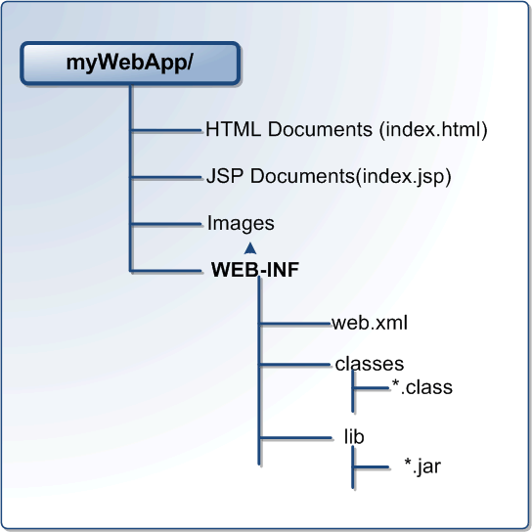

Slide 50
What Is the J2EE?
Open and standard based platform for
developing, deploying and managing
n-tier, Web-enabled, server-centric, and component-based enterprise applications

Slide 51

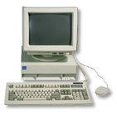
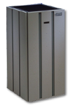


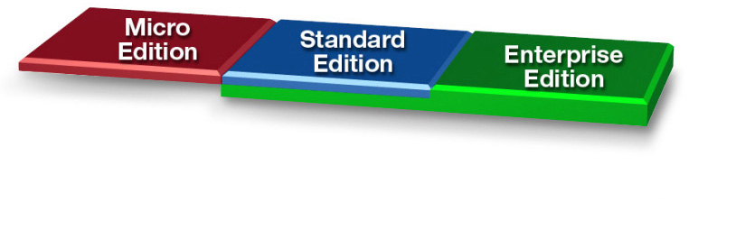
The Java™ Platform
Java Technology
Enabled Devices
Java Technology Enabled Desktop
Workgroup
Server
High-End
Server

Slide 52
What Makes Up JEE?
API and Technology specifications
Development and Deployment Platform
Standard and production-quality implementation
Compatibility Test Suite (CTS)
J2EE brand
J2EE Blueprints
Sample codes

Slide 53
Open and Standard Solution
Use "component and container" model in which container provides system services in a well-defined and as industry standard
J2EE is that standard that also provides portability of code because it is based on Java technology and standard-based Java programming APIs

Slide 54
Why J2EE?
Platform Value to Developers
Platform Value to Vendors
Platform Value to Business Customers

Slide 55
JEE APIs &
Technologies

Slide 56
J2EE 1.4 APIs and Technologies
Servlet 2.4
JSP 2.0
EJB 2.1
JAXR
Connector 1.5
JACC
JAXP 1.2
JavaMail 1.3
JAF 1.0
J2SE 1.4 (improved)
JAX-RPC (new)
Web Service for J2EE
J2EE Management
J2EE Deployment
JMX 1.1
JMS 1.1
JTA 1.0

Slide 57
Java EE 5
JAX-WS 2.0 & JSR 181
Java Persistence
EJB 3.0
JAXB 2.0
JavaSever Faces 1.2 – new to Platform
JSP 2.1 – Unification w/ JSF 1.2
StAX – Pull Parser – new to Platform

Slide 58
Servlet & JSP

Slide 59
What is a Servlet?
Java™ objects which extend the functionality of a HTTP server
Dynamic contents generation
Better alternative to CGI, NSAPI, ISAPI, etc.
Efficient
Platform and server independent
Session management
Java-based

Slide 60
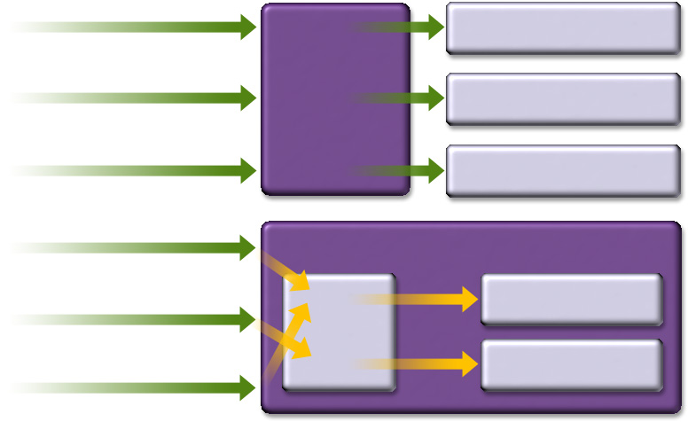
Servlet vs. CGI
Request CGI1
Child for CGI1
CGI
Based
Webserver
Request CGI2
Child for CGI2
Request CGI1
Child for CGI1
Request Servlet1
Servlet Based Webserver
Request Servlet2
Servlet1
JVM
Request Servlet1
Servlet2

Slide 61
What is JSP Technology?
Enables separation of business logic from presentation
Presentation is in the form of HTML or XML/XSLT
Business logic is implemented as Java Beans or custom tags
Better maintainability, reusability
Extensible via custom tags
Builds on Servlet technology

Slide 62
JEE is an End-to-End
Architecture

Slide 63
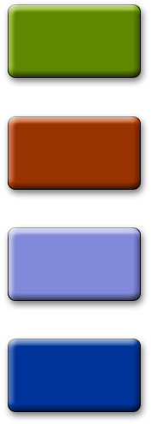
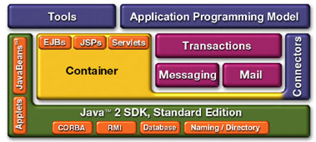
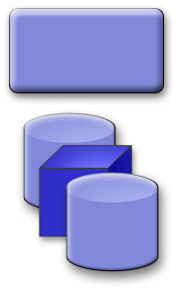
The J2EE Platform Architecture
B2B
Applications
Existing
Applications
B2C
Applications
Web Services
Application Server
Enterprise Information Systems
Wireless
Applications

Slide 64
N-tier J2EE Architecture

Slide 65
J2EE
Component & Container
Architecture

Slide 66
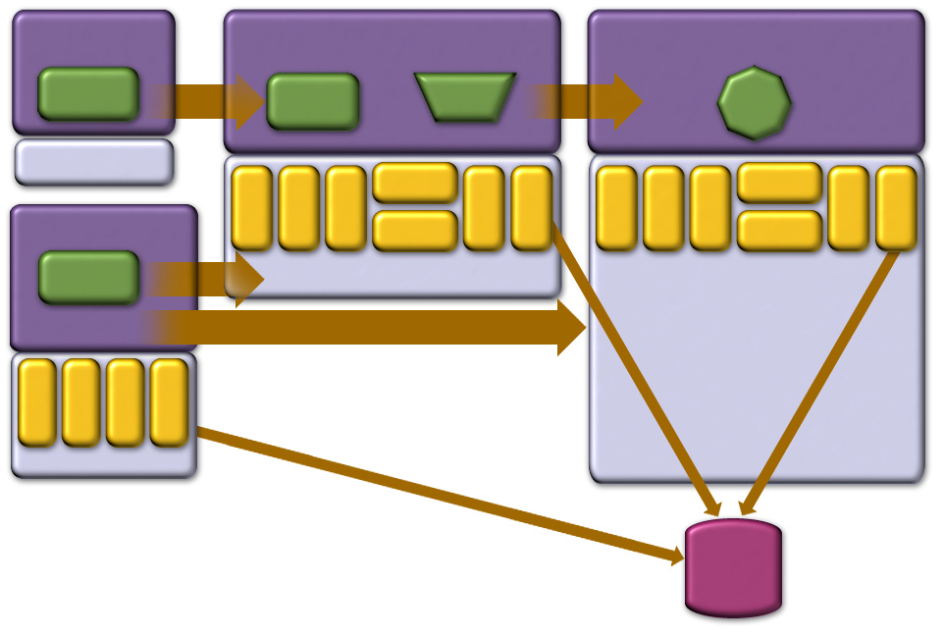
J2EE Containers & Components
Applet Container
Web Container
EJB Container
Applet
HTTP/ HTTPS
JSP
Servlet
RMI
EJB
J2SE
JavaMail
JavaMail
JNDI
JMS
JTA
RMI/IIOP
JDBC
App Client Container
JDBC
JNDI
JMS
JTA
RMI/IIOP
JAF
JAF
App Client
HTTP/ HTTPS
J2SE
RMI
JNDI
RMI/IIOP
JMS
JDBC
J2SE
J2SE
Database

Slide 68

Containers Handle
Components Handle
Concurrency
Security
Availability
Scalability
Persistence
Transaction
Life-cycle management
Management
Presentation
Business Logic

Slide 69
Containers & Components
Containers do their work invisibly
No complicated APIs
They control by interposition
Containers implement J2EE
Look the same to components
Vendors making the containers have great freedom to innovate

Slide 70
J2EE Application
Anatomies

Slide 71
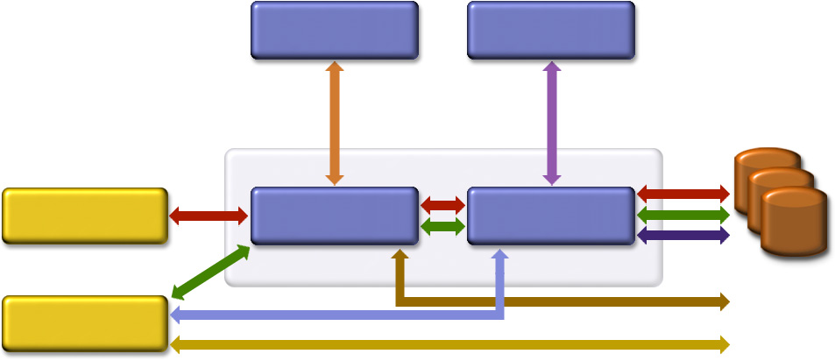
Possible J2EE Application Anatomies
Web Server
EJB Server
DB & EIS
Resources
Browser
Web Server
EJB Server
Stand-alone

Slide 72
J2EE Application Anatomies
4-tier J2EE applications
HTML client, JSP/Servlets, EJB, JDBC/Connector
3-tier J2EE applications
HTML client, JSP/Servlets, JDBC
3-tier J2EE applications
EJB standalone applications, EJB, JDBC/Connector
B2B Enterprise applications
J2EE platform to J2EE platform through the exchange of JMS or XML-based messages

Slide 73
Which One to Use?
Depends on several factors
Requirements of applications
Availability of EJB tier
Availability of developer resource

Slide 74
Servlet

Slide 75
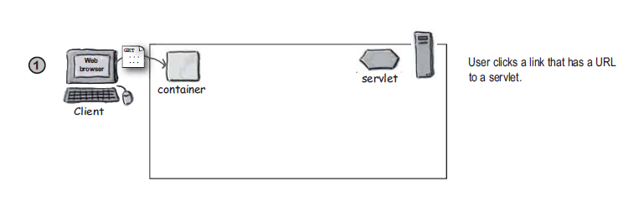
Servlets + Web Container

Slide 76
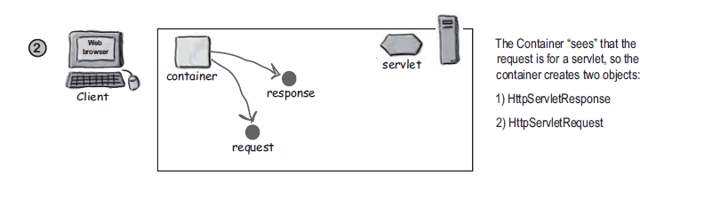

Slide 77
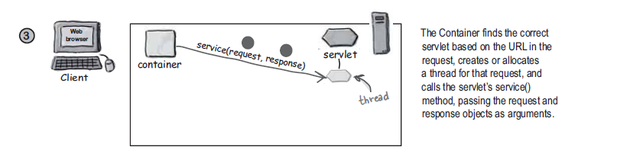

Slide 78
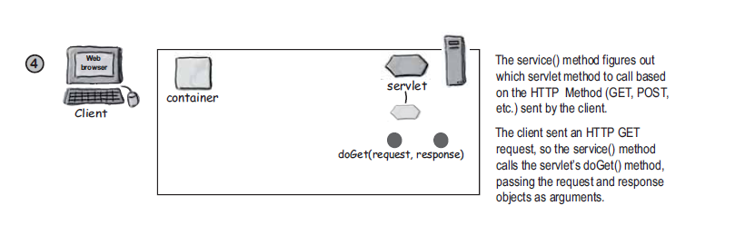

Slide 79
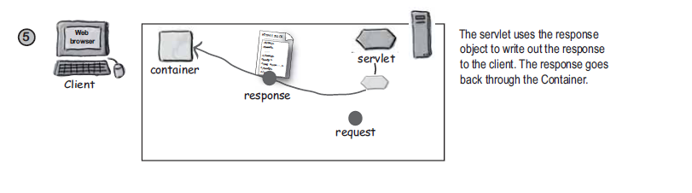

Slide 80
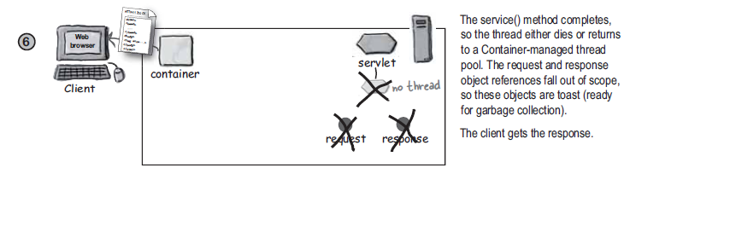

Slide 81
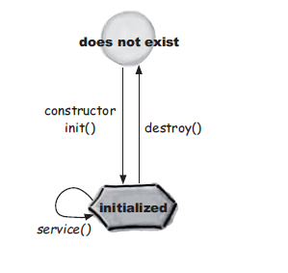
Servlet Life Cycle

Slide 82
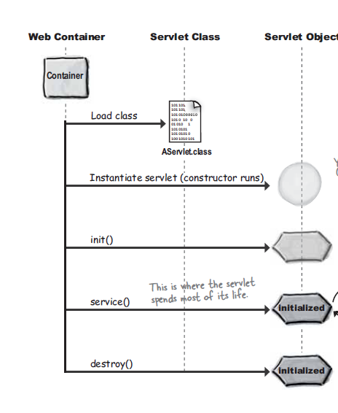

Slide 83
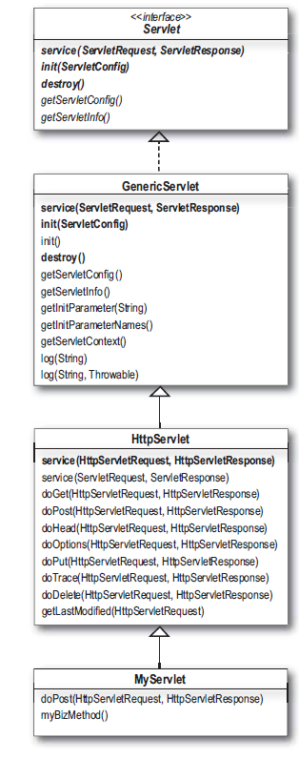

Slide 84
Each Request runs in separate thread.

Slide 85
